Slide 1
Chapter 6
Bandwidth
Utilization

Slide 2
Chapter 6: Outline
6.1 MULTIPLEXING
6.2 SPREAD SPECTRUM
Bandwidth utilization is the wise use of available bandwidth to achieve specific goals.
Efficiency can be achieved by multiplexing.
Privacy and anti-jamming can be achieved by spreading.

Slide 3
Chapter 6: Objective
The first section discusses multiplexing. The first method is called frequency-division multiplexing(FDM). The second method is called wavelength division multiplexing (WDM). The third method is called time-division multiplexing (TDM).
The second section discusses spectrum spreading, in which we first spread the bandwidth of a signal to add redundancy for the purpose of more secure transmission before combining different channels. The first method is called frequency hopping spread spectrum (FHSS). The second method is called direct sequence spread spectrum (DSSS).

Slide 4
6.1 Multiplexing
Topics discussed in this section:
6.1.1 Frequency-Division Multiplexing
6.1.2 Wavelength-Division Multiplexing
6.1.3 Synchronous Time-Division Multiplexing
6.1.4 Statistical Time-Division Multiplexing

Slide 5
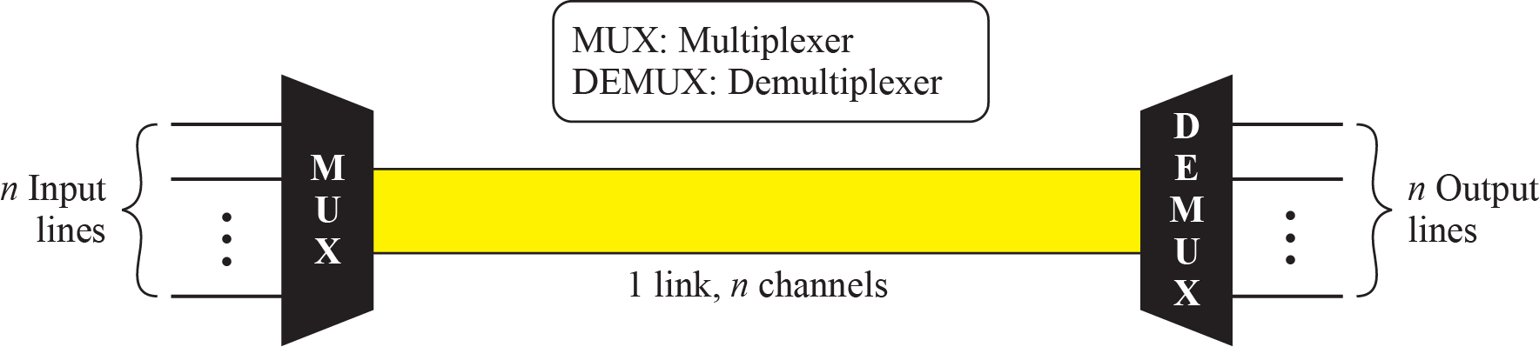
6.1 Multiplexing
Multiplexing
  Multiplexing allows the simultaneous transmission of multiple signals across a single data link.
    As data and telecommunications use increases, so does traffic.
    We can accommodate this increase by continuing to add individual links each time a new channel is needed.
  If we have higher-bandwidth link, it can be used to carry multiple signals.
n input lines share the bandwidth of one link.

Slide 6
6.1 Multiplexing
Multiplexer(MUX)
  MUX combines n-input lines into single stream(many to one).
Demultiplexer(DEMUX)
  DEMUX separates the stream back into their corresponding lines(one to many).
Link
  Physical path
Channel
  The portion of a link
  One link can have many channels.

Slide 7

6.1 Multiplexing
Categories of multiplexing

Slide 8
6.1.1 Frequency Division Multiplexing
FDM
  FDM is an analog technique that can be applied when the bandwidth of a link is greater than the combined bandwidths of the signals to be transmitted.
  In FDM, signals generated by each sending device modulate different carrier frequencies.
  These modulated signals are then combined into a single composite signal that can be transported by the link.

Slide 9
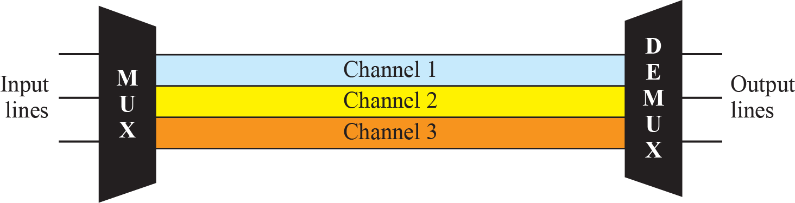
6.1.1 Frequency Division Multiplexing
FDM
FDM is an analog multiplexing technique
that combines analog signals.

Slide 10

6.1.1 Frequency Division Multiplexing
Multiplexing Process
  Each source generates a signal of a similar frequency range.
  These signals are modulated with different carrier frequencies.
  The modulated signals are combined into a single composite signal.

Slide 11

6.1.1 Frequency Division Multiplexing
Demultiplexing Process
  Demultiplexer uses a filters to decompose the multiplexed signal.
  The individual signals are passed to a demodulator that separates them from their carriers.

Slide 12
6.1.1 Frequency Division Multiplexing
Examples of FDM
  Radio
    AM : Each station is assigned a 10kHz,
    FM : Each station is assigned a 200kHz,
  TV
    Each channel is assigned a 6MHz,
  The 1G cellular telephone
    Each user is assigned two 30kHz channels, one for sending voice and the other for receiving.

Slide 13
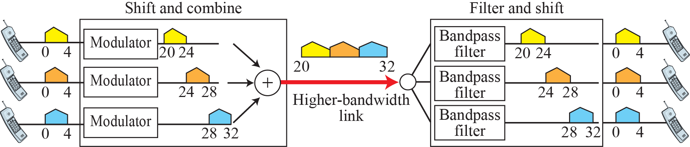
Example 6.1
A voice channel occupies a bandwidth of 4 kHz.
  We need to combine three voice channels into a link with a bandwidth of 12 kHz, from 20 to 32 kHz.
  Show the configuration, using the frequency domain.
Solution
  We shift (modulate) the three voice channels to a different bandwidth.

Slide 14

Example 6.2
Five channels are to be multiplexed together.
  Each with a 100kHz bandwidth.
  What is the minimum bandwidth of the link if there is a need for a guard band of 10kHz between the channels to prevent interference?
Solution
For five channels, we need at least four guard bands.
This means that the required bandwidth is at least
5×100 + 4×10 = 540 kHz.

Slide 15
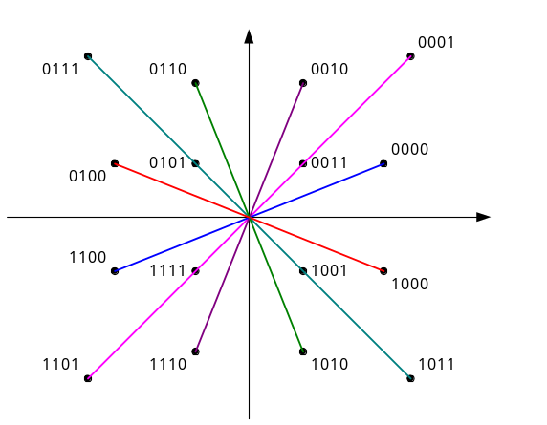

Example 6.3
Four data channels (digital), each transmitting at 1Mbps, use a satellite channel of 1MHz.
Design an appropriate configuration, using FDM.
Solution
The satellite channel is analog.
Divide 1Mbps digital channel into four channels,
each channel having a 250-kHz bandwidth.

Slide 16
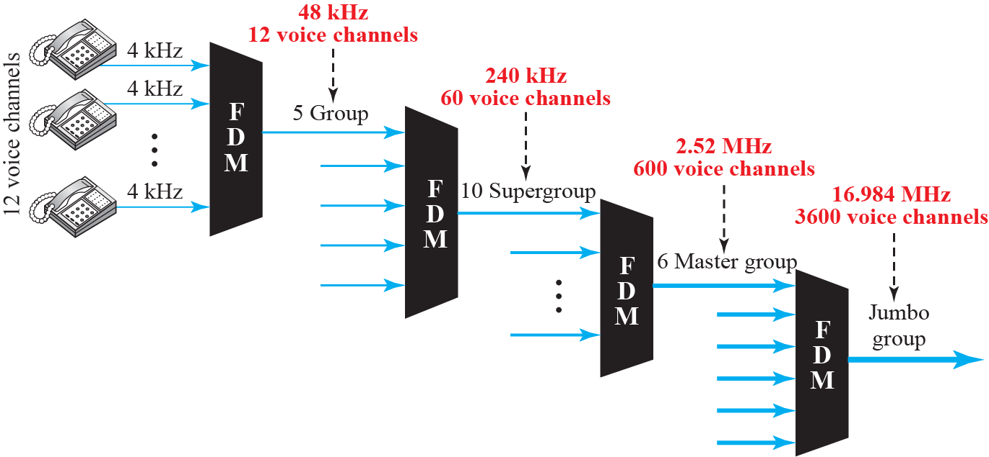
6.1.1 Frequency Division Multiplexing
Analog Hierarchy
  Multiplexing lower-bandwidth lines into higher-bandwidth lines.
  For analog lines, FDM is used.
guard band
guard band

Slide 17
6.1.1 Frequency Division Multiplexing
Other Application of FDM
  Radio broadcasting :
    Each station uses a different carrier frequency.
    AM : 10kHz is assigned for each station.
    FM : 200kHz is assigned for each station.
  TV broadcasting : 6MHz is assigned for each channel.
  1G Cellular Telephone :
    Each user is assigned two 30kHz channels.
    One for sending, the other for receiving

Slide 18
Example 6.4
The Advanced Mobile Phone System uses two bands.
  The first band of 824 to 849 MHz is used for sending, and
  869 to 894 MHz is used for receiving.
  Each user has a bandwidth of 30kHz in each direction.
  The 3kHz voice is modulated using FM, creating 30kHz of modulated signal.
  How many people can use their cellular phones simultaneously?
Solution
Each band is 25MHz.
If we divide 25MHz by 30kHz, we get 833.33.
In reality, the band is divided into 832 channels.
Of these, 42 channels are used for control.
Only 790 channels are available for cellular phone users.

Slide 19
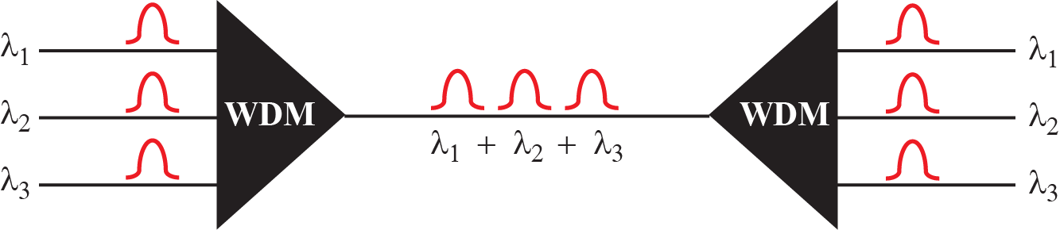
6.1.2 Wavelength Division Multiplexing
Wavelength-division multiplexing (WDM) is designed to use the high data rate capability of fiber-optic cable.
  The optical fiber data rate is higher than the data rate of metallic transmission cable.
  Using a fiber-optic cable for a single line wastes the available bandwidth.
  Multiplexing allows us to combine several lines into one.

Slide 20

6.1.2 Wavelength Division Multiplexing
Wavelength Division Multiplexing(WDM)
  The combining and splitting of light sources are easily handled by a prism.
WDM is an analog multiplexing technique to combine optical signals.

Slide 21
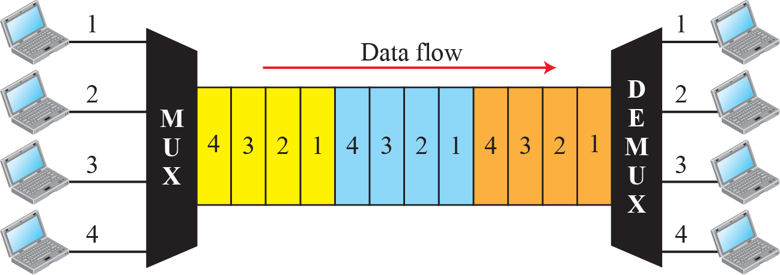
6.1.3 Time Division Multiplexing
Time-division multiplexing (TDM)
  TDM is a digital process that allows several connections to share the high bandwidth of a link.
  Each connection occupies a portion of time in the link.
  In the figure, portions of signals 1, 2, 3, and 4 occupy the link sequentially.

Slide 22
6.1.3 Time Division Multiplexing
Time-division multiplexing (TDM)
  Instead of sharing a portion of the frequency bandwidth as in FDM, time is shared.
  Two TDM :
    Synchronous TDM
    Statistical TDM
TDM is a digital multiplexing technique for combining several low-rate channels into one high-rate channel.

Slide 23
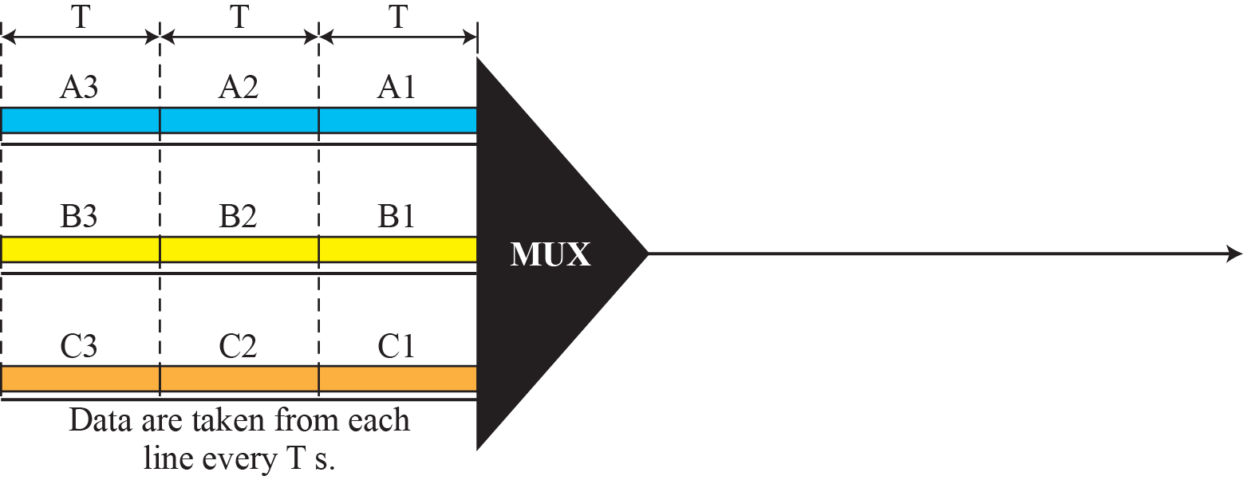
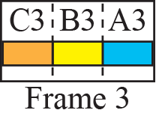
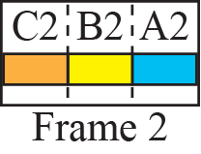
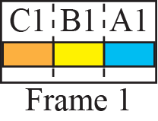
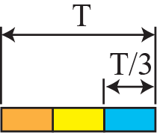

6.1.3 Time Division Multiplexing(TDM)
Figure 6.13: Synchronous time-division multiplexing
In synchronous TDM,
the data rate of the link is n times faster,
and the unit duration is n times shorter.

Slide 24
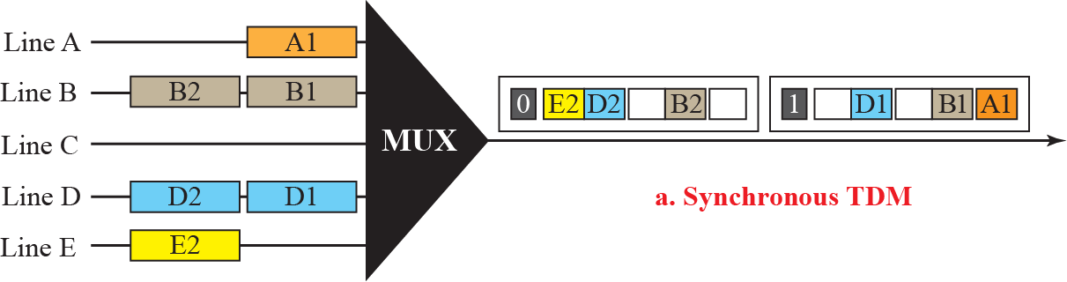
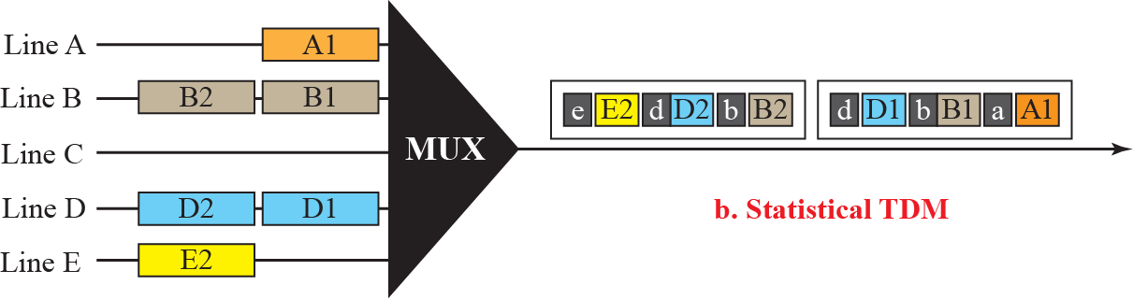
6.1.3 Time Division Multiplexing(TDM)
Figure 6.26: TDM slot comparison
There are no synchronous bit.
A slot need to carry data as well as address.

Slide 25
Example 6.5
Time Duration?
  In Figure 6.13, the data rate for each input connection is 1kbps.
  Assume 1bit at a time is multiplexed (a unit is 1bit).
  what is the duration of (a) each input slot, (b) each output slot, (c) each frame?
Solution
a. 1kbps means that the bit duration is 1/1000 s or 1ms.
The duration of the input time slot is 1ms (same as bit duration).
b. The duration of each output time slot is one-third of the input time slot.
This means that the duration of the output time slot is 1/3 ms.
c. Each frame carries three output time slots.
So the duration of a frame is 3 × (1/3) ms, or 1ms.
The duration of a frame is the same as the duration of an input unit.

Slide 26
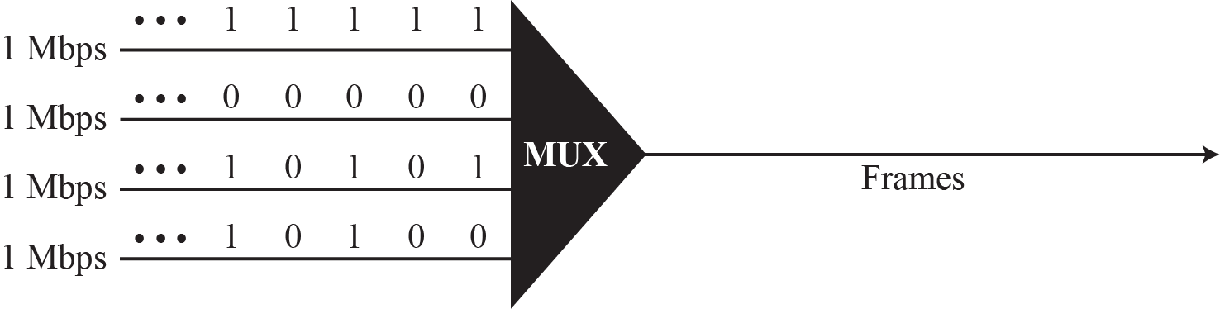
Example 6.6
Synchronous TDM
  Figure 6.14 shows four input data stream and one data stream for the output.
  The unit of data is 1bit.
  Find the duration of (1) input bit and (2) output bit, and the rate of (3) the output bit and (4) the output frame.
Figure 6.14 Example 6.6

Slide 27
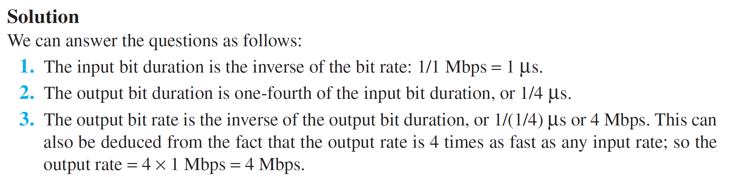
Example 6.6 (continued)
Solution

Slide 28
Example 6.7
Four 1kbps input connections are multiplexed together.
  What are (1) the duration of 1 bit before multiplexing,
  (2) the transmission rate of the link,
  (3) the duration of a time slot, and
  (4) the duration of a frame.
  A unit is 1 bit.
1 kbps
1 kbps
1 kbps
1 kbps

Slide 29
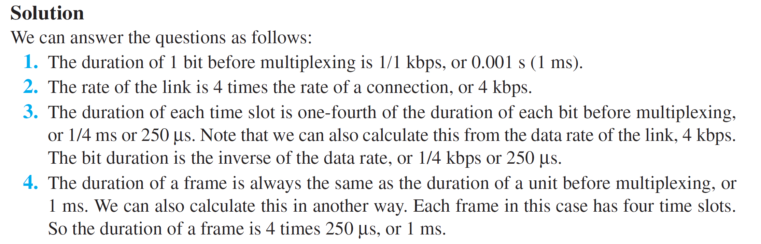
Example 6.7 (continued)
1 kbps
1 kbps
1 kbps
1 kbps

Slide 30

6.1.3 Time Division Multiplexing(TDM)
Interleaving
  TDM can be visualized as two fast-rotating switched.

Slide 31
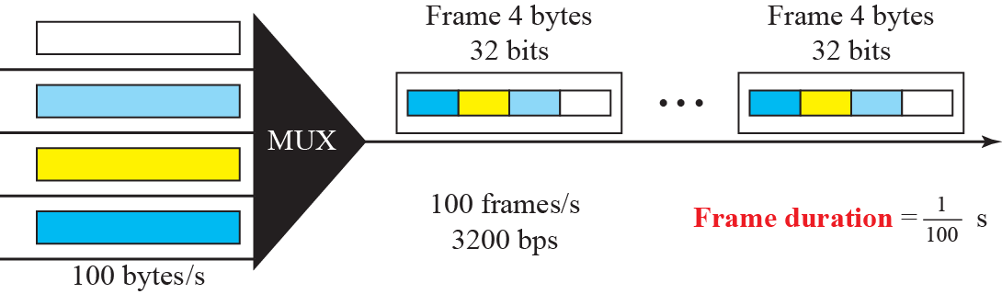
Example 6.8
Four channels are multiplexed using TDM.
  Each channel sends 100bytes/s and we multiplex 1byte per channel.
  Show the frame traveling on the link.
  What is the size and duration of a output frame, and the frame and bit rate for the link?

Slide 32
Example 6.8 (continued)
Solution
  Each output frame carries 1byte from each input channel; the size of each output frame is 4bytes.
  The frame rate is 100 frames per second.
  The duration of a frame is therefore 1/100s.
  The link is carrying 100 frames per second, and since each frame contains 32bits, the bit rate is 100 × 32 = 3200 bps.

Slide 33
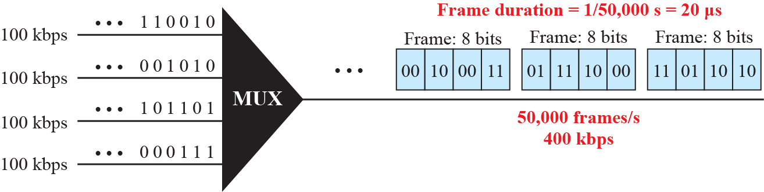
Example 6.9
A multiplexer combines four 100kbps channels using a time slot of 2bits.
  Show the output with four arbitrary inputs.
  What is the frame rate? What is the frame duration?
  What is the bit rate? What is the bit duration?
Time-slot

Slide 34
Example 6.9 (continued)
Time-slot
Solution
  The link carries 50,000 frames per second since each frame contains 2bits per channel.
  The frame duration is therefore 1/50,000 s or 20μs.
  The frame rate is 50,000 frames per second, and each frame carries 8 bits; the bit rate is 50,000 × 8 = 400kbps.
  The bit duration is 1/400,000 s, or 2.5μs.

Slide 35
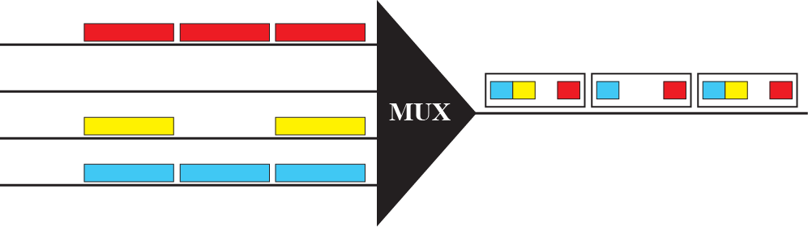
6.1.3 Time Division Multiplexing(TDM)
Empty Slots
  If a source does not have data to send, the corresponding slot in the output frame is empty.

Slide 36
6.1.3 Time Division Multiplexing(TDM)
If the data rate of all input lines are not the same, three strategies are used.
① Multilevel Multiplexing
② Multiple-Slot Allocation
③ Pulse Stuffing

Slide 37
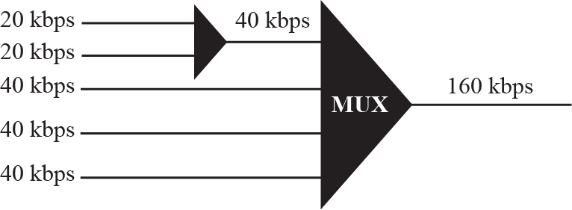
6.1.3 Time Division Multiplexing(TDM)
Multilevel Multiplexing
  The technique used when the data rate of an input line is a multiple of others.

Slide 38
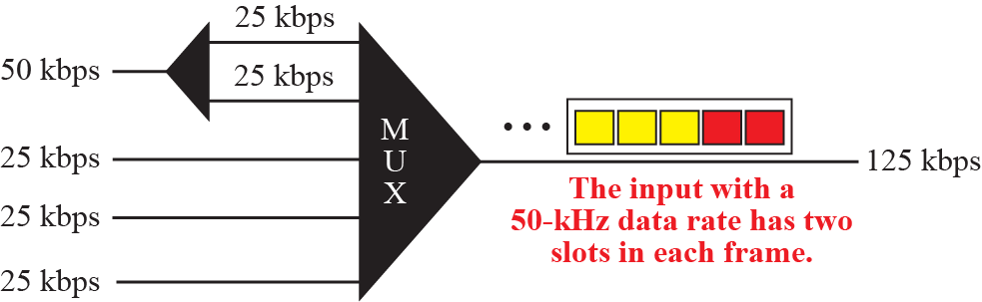
6.1.3 Time Division Multiplexing(TDM)
Multiple-Slot Allocation
  The technique allowing more than one slot in a frame to a single input line.

Slide 39
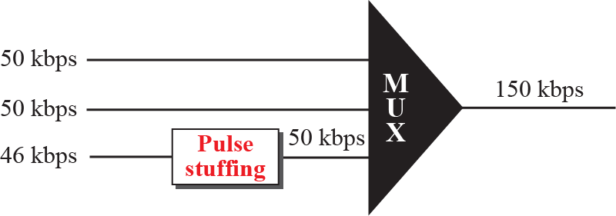
6.1.3 Time Division Multiplexing(TDM)
Pulse Stuffing
  Adding dummy bits to the input lines with lower rates to balance the highest input data rates.
  Called Bit Padding or Bit Stuffing

Slide 40
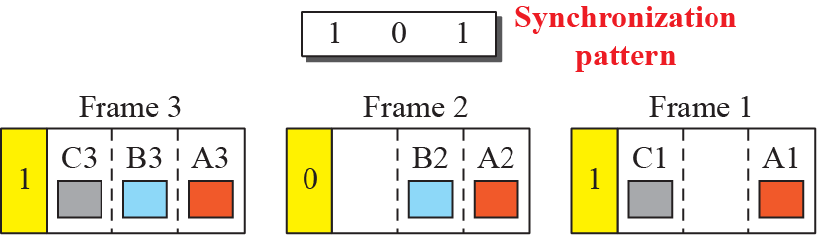
6.1.3 Time Division Multiplexing(TDM)
Frame Synchronization
  One or more synchronization bits are added to the beginning of each frame.

Slide 41
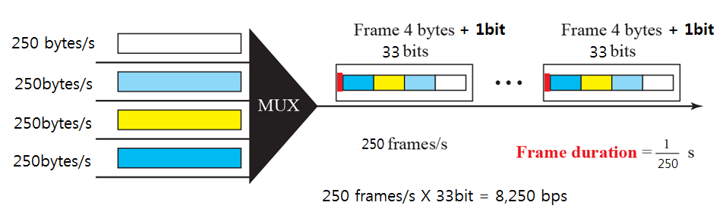
Example 6.10
Four sources, each creating 250 characters per second
  If the interleaved unit is a character and 1 synchronizing bit is added to each frame,
  Find (1) the data rate of each input source, (2) the duration of each character in each source, (3) the frame rate, (4) the duration of each frame, (5) the number of bits in each frame, and (6) the data rate of the link.
Solution
(1) The data rate of each source is 250 × 8 = 2000 bps = 2kbps.

Slide 42
Example 6.10 (continued)
(2) Each source sends 250 characters per second;
therefore, the duration of a character is 1/250 s, or 4 ms.
(3) Each frame has one character from each source,
which means the link needs to send 250 frames per second.
(4) The duration of each frame is 1/250 s, or 4 ms.
(5) Each frame carries 4 characters and 1 extra synchronizing bit.
This means that each frame is 4 × 8 + 1 = 33 bits.
(6) The link sends 250 frames per second, and each frame contains 33 bits.
This means that the data rate of the link is 250 × 33 = 8250 bps.

Slide 43
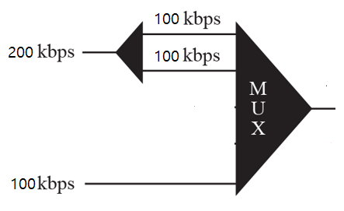
Example 6.11
Two channels having different bit rate are multiplexed.
  One channel is 200 kbps and another is 100 kbps of bit rate.
  How this can be achieved? What is the frame rate? What is the frame duration? What is the bit rate of the link?.

Slide 44
Example 6.11 (continued)
Solution
  We can allocate two slot to the first channel and
  one slots to the second channel. Each frame carries 3 bits.
  The frame rate is 100k frames per second because it carries 1 bit from the input channel.
  The frame duration is 1/100k s = 10ms.
  The bit rate is 100k frames/s × 3 bits per frame = 300 kbps.

Slide 45
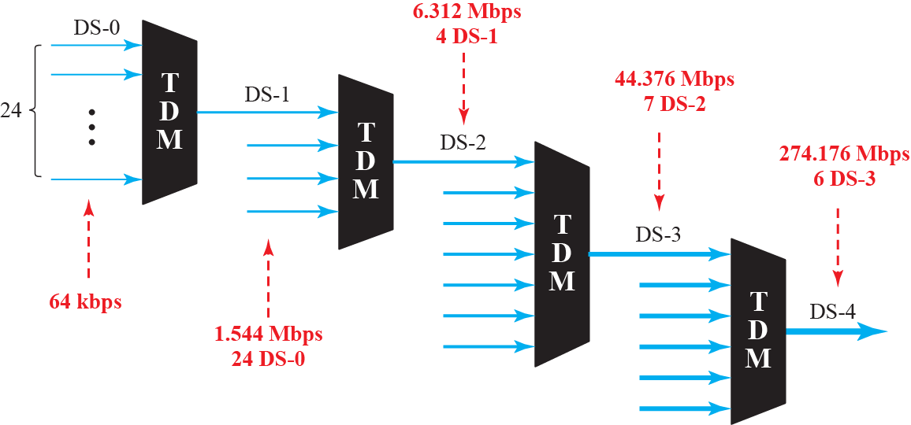
6.1.3 Time Division Multiplexing(TDM)
Digital Signal (DS) Service
  Telephone companies implement TDM through a hierarchy of digital signals, called digital hierarchy.
하나의 Call 당 64Kbps의 Bandwidth가 필요함
4000Hz x 2 x 8 bit per sample = 64,000 bit per second(64 Kbps)
한 통화당 64Kbps가 필요하고, 이를 DS0이라도 함

Slide 46
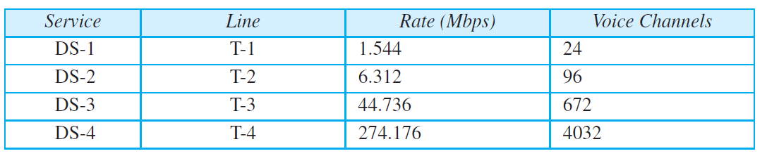
6.1.3 Time Division Multiplexing(TDM)
DS-.. are the name of service, and
these services are implemented by T lines.
  DS-0 : Single digital channel of 64 kbps.
  DS-1 : 24 DS-0, 24 times 64Kbps + 8Kbps of overhead
  DS-2 : 4 DS-1, 96 times 64Kbps + 168Kbps of overhead
  DS-3 : 7 DS-2, 672 times 64Kbps + 1.368Mbps of overhead
  DS-4 : 6 DS-3, 4032 times 64Kbps + 16.128Mbps of overhead

Slide 47
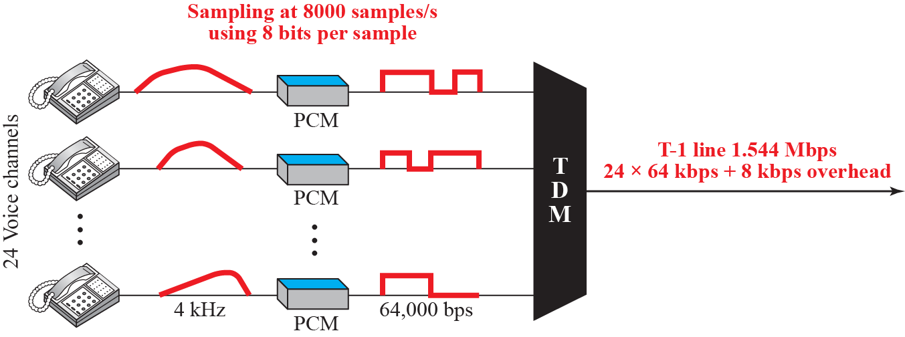
6.1.3 Time Division Multiplexing(TDM)
T lines for Analog Transmission(for USA)
  T lines are digital lines designed for the transmission of digital data, audio, voice. They can be used for analog transmission.
  24 lines (each 64Kbps) are combined into one T-1 line (1.544Mbps).
다중화 단위는 8bit
1초에 8000Frame 전송

Slide 48
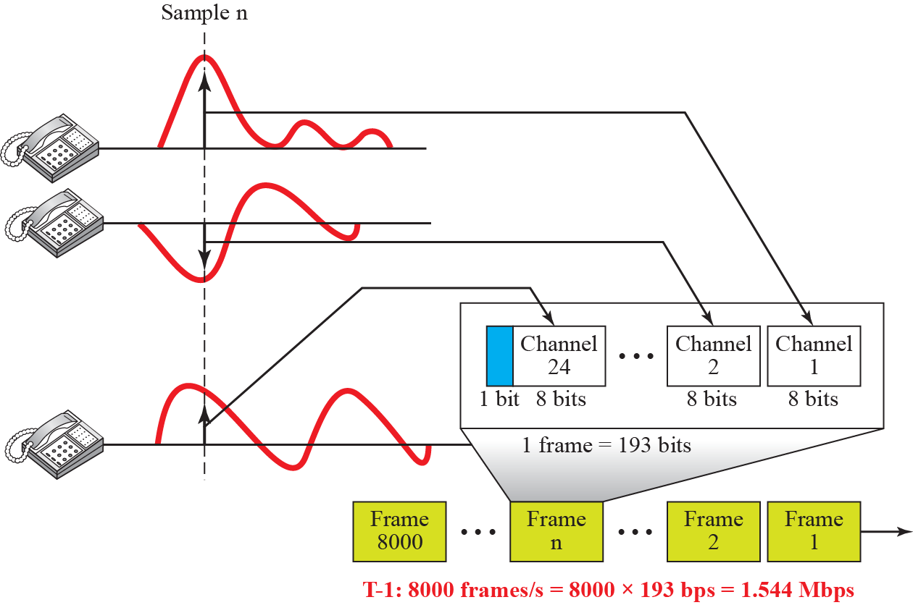
6.1.3 Time Division Multiplexing(TDM)
T-1 Frame Structure
  T-1 line is usually 193 bits. (24 channels X 8 bits + 1 sync = 193)

Slide 49
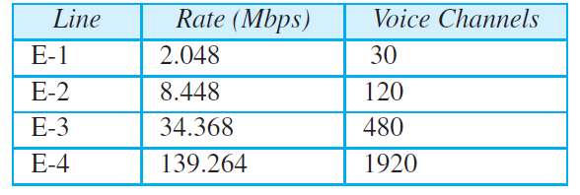
6.1.3 Time Division Multiplexing(TDM)
E Lines
  European version of T lines.
  32 channels(2 control channels + 30 data channels)
Time slot 0, 16
Time slot 1~15, 17~31
1 frame = 32 time slot = 256 bit = 125 us
 | 31 | 0 | 1 | 2 | 3 | 4 | … | 14 | 15 | 16 | 17 | 18 | … | 29 | 30 | 31 | 0
Time slot 0
Time slot 16
Time slot 30
8bit Framing & Synchronous & Alarms
8bit Signaling
8bit code

Slide 50
6.1.3 Time Division Multiplexing(TDM)
Statistical TDM
  No slot is left empty in the line.
In TDM, there is no need for addressing.
In Statistical TDM, a slot needs to carry the address of the destination.

Slide 51
6.2 Spread Spectrum
Spread Spectrum is designed to be used in wireless applications(LANs and WANs).
  Stations share air medium without interception and jamming from malicious intruders.
To achieve these goals, Spread Spectrum techniques add redundancy.
  They spread the original spectrum.
Topics discussed in this section:
6.2.1 Frequency Hopping Spread Spectrum (FHSS)
6.2.2 Direct Sequence Spread Spectrum Synchronous (DSSS)

Slide 52
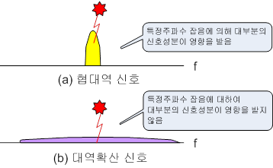
6.2 Spread Spectrum
Spread Spectrum
  A signal generated with a particular bandwidth is deliberately spread in a signal with a wider bandwidth.
  Benefits :
    establishment of secure communications.
    Increasing resistance to interference, noise and jamming.
    Preventing detection.

Slide 53
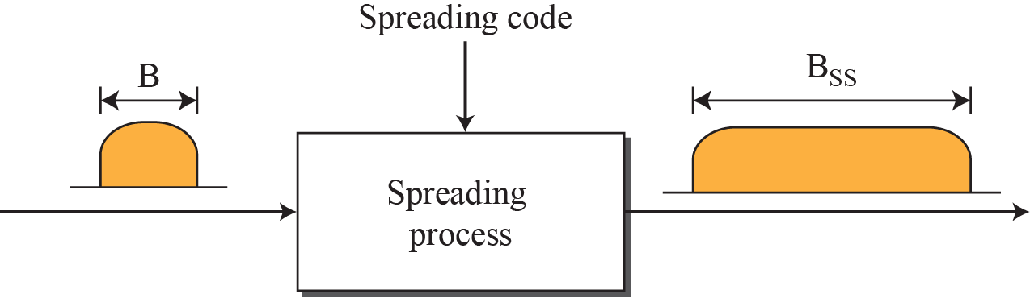
6.2 Spread Spectrum
Spread Spectrum
  At first, the signals are modulated by PSK or FSK.
  The spreading process uses a spreading code and spreads the bandwidth. (secondary modulation)
  If the required bandwidth for each station is B, spread spectrum expands it to B_{ss} such that B_{ss} >> B.

Slide 54
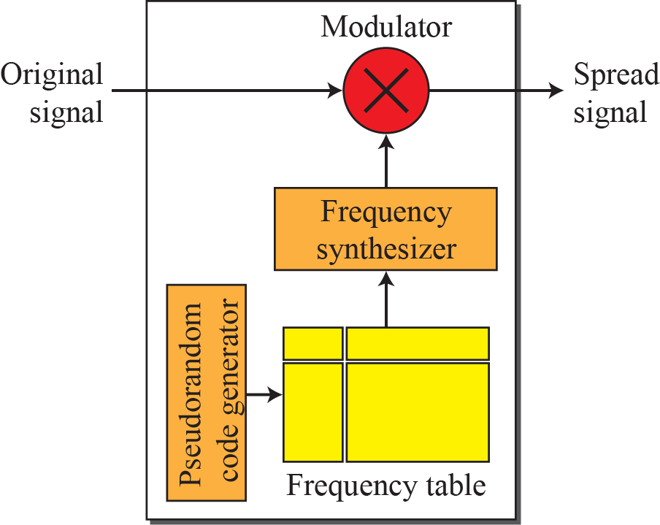
6.2.1 Frequency Hopping Spread Spectrum
Frequency Hopping Spread Spectrum(FHSS)
  FHSS uses M different carrier frequencies.
  At one moment, the signal modulates one carrier frequency; at the next moment, the signal modulates another carrier frequency.
  Used in Bluetooth

Slide 55

6.2.1 Frequency Hopping Spread Spectrum
Frequency selection in FHSS
  A pseudorandom code generator creates a k-bit pattern for every hopping period.

Slide 56
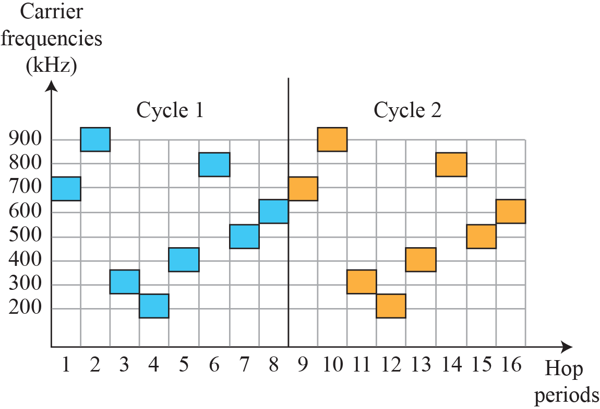
6.2.1 Frequency Hopping Spread Spectrum
FHSS Cycles

Slide 57
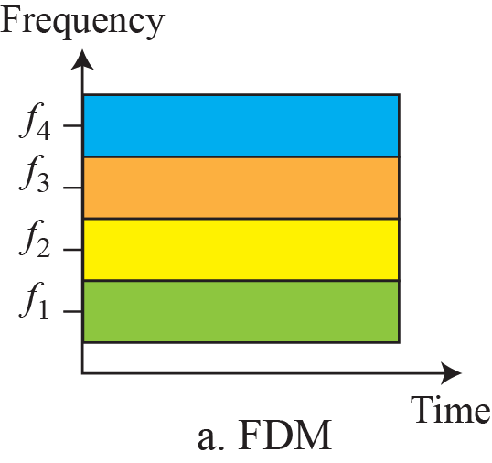
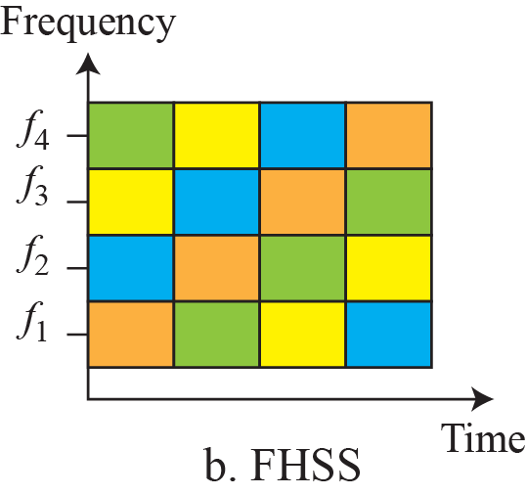
6.2.1 Frequency Hopping Spread Spectrum
Bandwidth Sharing

Slide 58

6.2.2 Direct Sequence Spread Spectrum
Direct Sequence Spread Spectrum(DSSS)
  The DSSS replaces each data bit with n bits using a spreading code.
    To get the spread signals, the original signals are multiplied by the chip sequence.
  Each bit is assigned a code of n bits, called chips.
    The chip rate is n times that of the data bit.

Slide 59

6.2.2 Direct Sequence Spread Spectrum
The famous Barker sequence used in wireless,
n is 11.
Example of Barker Sequence in wireless LAN (1)
  The spreading code is 11 Chip Sequence having the pattern‘10110111000’

Slide 60
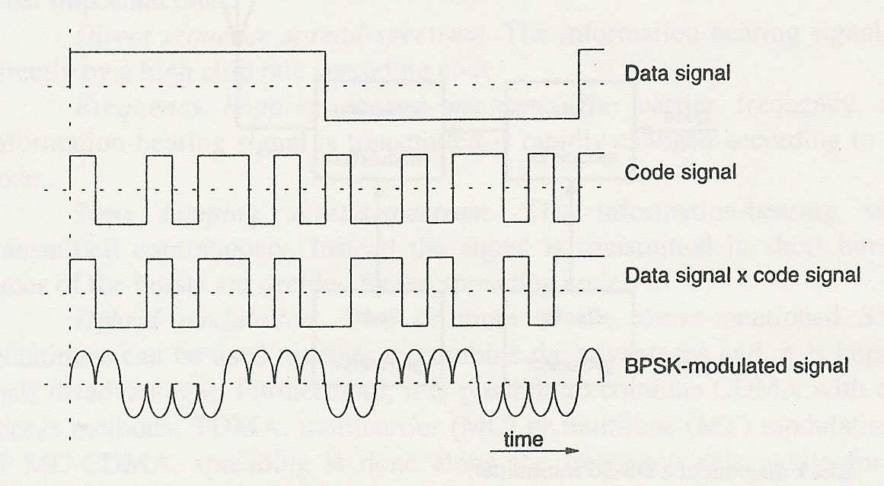
6.2.2 Direct Sequence Spread Spectrum
Example of Barker Sequence in wireless LAN (2)
  Chip Sequence is‘1001011010’.
1
0

Slide 61
6.2.2 Direct Sequence Spread Spectrum
More broad bandwidth are needed for DSSS.
  The Barker chip is 11 bits, which means that it increases the bit rate 11 times.
  A voice channel of 64 kbps needs 11 × 64 kbps = 704 kbps.
  The bandpass channel using 20 Mbps can carry approximately 28 channels. (20 Mbps) / (704 kbps)

Slide 62
6.3 Summary
Multiplexing is the techniques that allow the simultaneous transmission of multiple signals across a single data link.
Frequency-division multiplexing (FDM)
  FDM is an analog multiplexing technique that combines analog signals
Time-division multiplexing (TDM)
  TDM is a digital multiplexing technique for combining several low-rate channels into one high-rate channel.
    Synchronous TDM
    Statistical TDM

Slide 63
6.3 Summary
The spectrum spreading is the techniques for the secure transmission that spread the bandwidth of a signal.
Frequency Hopping Spread Spectrum (FHSS)
  FHSS uses M different carrier frequencies.
Direct Sequence Spread Spectrum (DSSS)
  The DSSS replaces each data bit with n bits using a spreading code.

